Slide 1
THE PERIODONTIC-ENDODONTIC CONTINUUM
RUNGTA COLLEGE OF DENTAL SCIENCES AND RESEARCH,BHILAI
Presented by-
Dr Sonika Bodhi
Reader
Dept of periodontics

Slide 2
SPECIFIC LEARNING OBJECTIVES
CORE AREAS | DOMAIN | CATEGORY
Introduction | Affective | Desire to know
Pathways of communication | Cognitive | Nice to know
Pulpal disease | Cognitive | Nice to know
Effect of pulpal diseases on the periodontal tissues | Cognitive | Nice to know
Effect of periodontal inflammation on the pulp | Cognitive | Nice to know
Classification of Endo-Perio lesion | Cognitive | Must to know

Slide 3
SPECIFIC LEARNING OBJECTIVES
CORE AREAS | DOMAIN | CATEGORY
Differentiation between Periodontal and Pulpal disease | Cognitive | Must to know
Differentiation between Periodontal and Periapical abscess | Cognitive | Must to know
Diagnostic procedures | Psychomotor | Must to know
Management | Cognitive | Must to know
Special issues in endodontic therapy | Cognitive | Must to know

Slide 4
CONTENTS
Introduction
Pathways of communication
Pulpal disease
Etiological factors
Classification
Effects on periodontium
Effect of pulpal diseases on the periodontal tissues
Effect of periodontal inflammation on the pulp
Classification of Endo-Perio lesion

Slide 5
CONTENTS
Differentiation between Periodontal and Pulpal disease
Differentiation between Periodontal and Periapical abscess
Diagnostic procedures
Management
Special issues in endodontic therapy
Potential Complications
Restorative implications
Summary
References

Slide 6
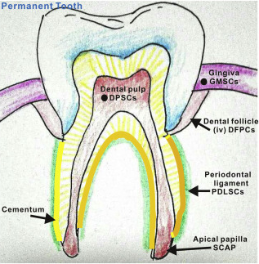
INTRODUCTION
The Periodontium and pulp have embryonic, anatomic and functional Interrelationships.
Embryonically, the pulp originates from the dental papilla and the periodontal ligament from the dental follicle.

Slide 7
INTRODUCTION
The relationship between periodontal and pulpal disease was first described by Simring and Goldberg in 1964.
The simultaneous existence of pulpal problems and inflammatory periodontal disease can complicate diagnosis and treatment planning and affect the sequence of care to be performed.

Slide 8
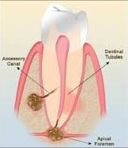
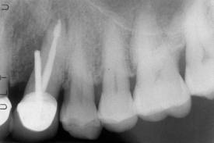
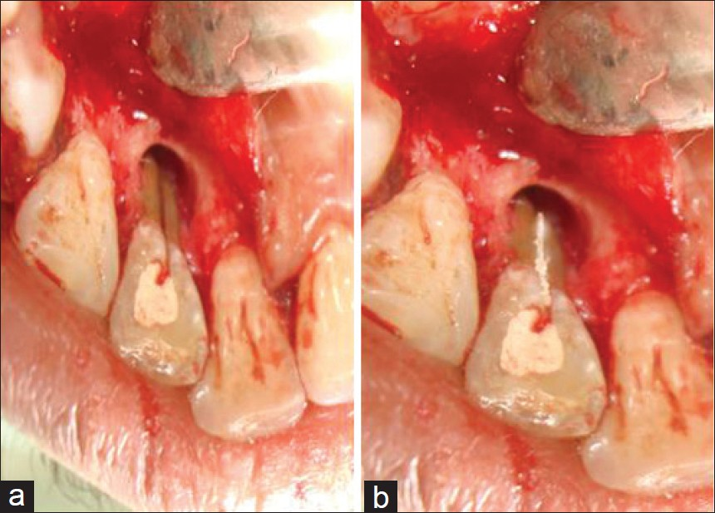
PATHWAYS OF COMMUNICATION
The possible pathways for ingress of bacteria and their
products into these tissues can broadly be divided into:
Anatomical Pathways
Apical foramen
Lateral and accessory canals
Dentinal tubules
Non-physiological Pathways:
Root canal perforation
Vertical root fracture
Palatogingival grooves

Slide 10
Living Pathogens:
Bacteria
Fungi
Viruses
Non-living etiologic agents:
- Extrinsic agents: Dentin and cementum chips, amalgam, root canal filling materials, cellulose fibers from absorbent paper points, calculus.
- Intrinsic agents: Cholesterol, Russell bodies, Rushton hyaline bodies, Charcot-Leyden Crystals.

Slide 11
PULPAL DISEASE.......Etiological factors
Instrumentation during periodontal, restorative, or prosthetic dentistry
The progression of dental caries; and
Direct, local trauma such as tooth fracture.
The extent of inflammation of the pulp and the signs and symptoms that result vary with the severity of the insult and the ability of the host to ameliorate the inflammation that results.

Slide 12
Genus of Bacteria | Gram Stain
Eubacterium | Gram positive, nonmotile
Peptostreptococcus | Gram positive, nonmotile
Fusobacterium | Gram negative, nonmotile
Porphyromonas | Gram negative, nonmotile
Prevotella | Gram negative, nonmotile
Streptococcus | Gram positive, nonmotile
Lactobacillus | Gram positive, nonmotile
Wolinella | Gram negative, nonmotile
Actinomyces | Gram-positive rod, nonmotile

Slide 13
PULPAL DISEASE.......Classification
Reversible pulpitis
Irreversible pulpitis
Hyperplastic pulpitis
Pulpal necrosis

Slide 14
Minor injury such as periodontal root planing or the conservative preparation of a tooth for a restoration may lead to pulpal symptoms.
A transient hypersensitivity to thermal stimuli is the most common symptom noted.
The application of a thermal stimulus results in a brief, painful response that varies in intensity from mild to severe.
The response rapidly disappears after removal of the stimulus. The reversibility of inflammation and symptoms, without permanent pulpal damage..... REVERSIBLE PULPITIS

Slide 15
If the pulp is affected to the point that the inflammatory lesion cannot be resolved, even though the source of the trauma is eliminated, a progressive degeneration of the pulp results.
This progression has been described as IRREVERSIBLE PULPITIS
The patient may have no symptoms or may have intermittent or continuous episodes of spontaneous pain.
Irreversible pulpitis ultimately leads to LOSS OF PULPAL VITALITY (NECROSIS).

Slide 16
Effect of pulpal disease on periodontium
Pulpal tissue may be significantly inflamed and yet exert little or no effect on the periodontium.
As long as the pulp remains vital, it is unlikely that significant changes will occur in the periodontium.
Necrosis of the pulp, however, can result in bone resorption and the production of radiolucency at the apex of the tooth, in the furcation (molars), or at points along the root.

Slide 17
The resulting lesion may be an acute apical lesion or abscess, a more chronic periradicular lesion (cyst or granuloma), or a lesion associated with a lateral or accessory canal.
The lesion may remain small, or it can expand sufficiently to destroy a substantial amount of the attachment of the tooth and communicate with a lesion of periodontitis.

Slide 18
Classification of Periradicular Lesions
Acute apical periodontitis
Chronic apical periodontitis
Condensing osteitis
Acute apical abscess
Chronic apical abscess

Slide 19
The histopathologic structure of the periapical inflammatory lesion is
usually a highly vascularized granulation tissue infiltrated to varying degrees by inflammatory cells.
Neutrophils may be present near the apical foramen, whereas plasma cells, macrophages, lymphocytes, and fibroblasts are increased in the periphery of the lesion.
Similar lesions may develop adjacent to accessory or lateral canals.
Lateral canals are usually not visible on x-ray films and are most often identified only when the root and lateral canal has been filled with a radiopaque material during endodontic therapy

Slide 20
The majority of these canals occur in the apical portion of the root, with decreased numbers in the furcation area and are more common in posterior teeth.
The prevalence of lateral canals in the middle and cervical areas of the root and the prevalence of endodontic-derived lesions in the marginal periodontium through lateral or accessory canals are low.
Necrotic pulps apparently exert no effect through the dentinal tubules on the cementum.

Slide 22
EFFECT OF PERIODONTITIS ON THE DENTAL PULP
A clear-cut relationship between periodontitis and pulpal involvement is less evident and Periodontitis rarely produces significant changes in the dental pulp.
Bacteria and the inflammatory products of periodontitis could gain access to the pulp through accessory canals, apical foramina, or dentinal tubules......which may induce secondary pulpal infection, referred as RETROGRADE PULPITIS.

Slide 23
As long as the microvasculature of the apical foramina remains intact, and the accessory canals are protected by sound cementum, the pulp maintains its vitality and plaque bacteria does not affect the pulp.
Severe breakdown of the pulp apparently does not occur until periodontitis has reached a terminal state, that is, when bacterial plaque has involved the main apical foramina.
Fibrosis, calcifications and collagen resorption have been reported in the pulps of the teeth with long-standing periodontal disease.

Slide 24
CLASSIFICATION OF ENDO-PERIO LESIONS...... Simon, Glick and Frank in 1972 :
Primary Endodontic Lesions
Primary Periodontal Lesions
Primary Endodontic Lesions with secondary periodontal involvement
Primary Periodontal Lesions with secondary endodontic involvement
True combined lesions with concomitant pulp and periodontal lesions

Slide 25
Originally an endodontic problem, with fistulization from the apex and along the root to the gingiva. Pulpal infection can also spread through accessory canals to the gingiva or the furcation.

Slide 26
Longstanding periapical lesion draining through the periodontal ligament can become secondarily complicated, leading to a retrograde periodontitis.

Slide 27
Periodontal pocket can deepen to the apex and secondarily involve the pulp. Periodontal pocket can infect the pulp through a lateral canal, which in turn can result in a periapical lesion. Two independent lesions, periapical and marginal, can coexist and eventually fuse with each other

Slide 28
DIFFERENTIATION BETWEEN PERIODONTAL AND PULPAL DISEASE
Signs and Symptoms of Periodontitis:
attachment loss and periodontal pocket formation.
Bleeding on brushing and flossing
Bad breath
suppuration
increasing tooth mobility

Slide 29
DIFFERENTIATION BETWEEN PERIODONTAL AND PULPAL DISEASE
Signs and Symptoms of Pulpitis:
Pulpal sensation by stimulating dentin is usually fast, sharp, and severe and is mediated by A-delta myelinated fibers.
Sensation from the core of the pulp is initiated by smaller, unmyelinated C fibers and this pain is slow, dull, and more diffuse.

Slide 30
Sensitivity to hot and cold fluids
Thermal stimuli or percussion applied to teeth with irreversible pulpitis provokes severe pain for long time, which is intense and is often described as “bright” or “throbbing” .
Infection from pulp when extends to involve the periodontal ligament, the affected tooth becomes tender to pressure, biting, or light tapping with an instrument.

Slide 31
DIFFERENTIATION BETWEEN PERIODONTAL AND PERIAPICAL ABSCESS
Periodontal abscess:
not severely painful.
Lesion is sensitive to touch, mastication, brushing, flossing or any stimulus.
Formation of sinus and fistula is less common.
Patient becomes aware of the sore and tender lesion in the gingiva, which is present as a swelling or lump.

Slide 32
DIFFERENTIATION BETWEEN PERIODONTAL AND PERIAPICAL ABSCESS
Periapical abscess:
It is acute in nature and is associated with the pain because of the involvement of the periodontal ligament and elevation of the periosteum.
There is facial swelling because of the periosteum involvement.
It communicates directly with external soft tissue surface by a sinus tract and a stroma through the oral mucosa or the gingiva.
When the periapical abscess drains through the pocket, the lesion becomes true combined lesion.
The lesion becomes chronic when it drains through the sinus.

Slide 33
DIAGNOSIS
Accurate diagnosis can be achieved by careful history taking, clinical examination and use of special tests.
In primary periodontal disease, the pulp is vital and responsive to pulp testing.
While in primary endodontic disease, the pulp is infected and non– vital and gives abnormal or no response to pulp tester.
True combined lesions and other endo-perio lesions are clinically and radiographically very similar.

Slide 34
DIAGNOSIS
The following aids are useful in making appropriate diagnosis:
Periapical radiographs
Pulp vitality testing
Percussion
palpation
Pocket probing
Sinus tract tracking
Cracked tooth testing
Transillumination

Slide 35
MANAGEMENT OF PULPAL AND PERIODONTAL DISEASE
Patients with pulpal disease may have a healthy periodontium, gingivitis, or varying amounts of attachment loss (periodontitis) on the affected or adjacent teeth.
Treatment procedure is based on the appropriate diagnosis.

Slide 36
The prognosis and treatment of each endo/perio disease type varies………..
Primary endodontic lesions should only be treated by endodontic therapy and has a good prognosis .
Primary periodontal lesions should only be treated by periodontal therapy i.e. phase I therapy and surgical procedure if required.
…………………..the prognosis depends on severity of the periodontal disease and patient response to treatment.

Slide 37
Combined lesions should be treated with endodontic therapy first.
Treatment should be evaluated in 2-3 months, and only then periodontal treatment should be considered.
This sequence allows for sufficient time for initial tissue healing and better assessment of the periodontal condition to determine the need of non-surgicalor surgical treatment.
Prognosis depends on the periodontal involvement and treatment.

Slide 38
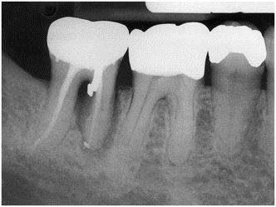
Special issues in Endodontic therapy
Potential Complications
Perforations of the floor of the pulp chamber or the root during access, canal instrumentation, or post preparation. Root resorption and vertical root fracture.

Slide 39
Special issues in Endodontic therapy
Restorative Implications
Ultimately, most root canal–treated teeth require restorations.
Although the initial success rate for endodontic therapy is quite high, long-term retention and function depend greatly on the ability to restore the tooth adequately.

Slide 40
SUMMARY
Pulpal and periodontal diseases are related in that both involve an inflammatory process.
The location and severity of the inflammation result in a characteristic degree of tissue involvement, which in turn helps the clinician select the appropriate therapeutic approach.
Proper diagnosis & management of endo-perio is must for complete resolution of symptoms and prolonging the tooth life.

Slide 41
REFERENCES
Newman MG, Takei HH, Klokkevold PR, Carranza FA. Carranza’s clinical periodontology, 10th ed. Saunders Elsevier; 2007.
Lindhe J, Lang NP and Karring T. Clinical Periodontology and Implant Dentistry. 6th ed. Oxford (UK): Blackwell Publishing Ltd.; 2015.
Newman MG, Takei HH, Klokkevold PR, Carranza FA. Carranza’s clinical periodontology, 13th ed. Saunders Elsevier; 2018.

